Slide 1
CHESS PAWN DETECTION
- Hrithika Charukula

Slide 2
Problem Statement
For someone who’s interested to start playing chess, the first thing they’re supposed to do is get to know about the chess pieces.
This Chess Pawn Detection model could be one solution helping them to just click a picture and get to know what chess piece is that.

Slide 3
Dataset
The dataset is taken from https://public.roboflow.com/object-detection/chess-full
This is a dataset of Chess board photos and various pieces.
The bounding boxes of all pieces are annotated as follows: white-king, white-queen, white-bishop, white-knight, white-rook, white-pawn, black-king, black-queen, black-bishop, black-knight, black-rook, black-pawn.
Total images : 866
- Train : 808
- Test : 58
- Validation : 58

Slide 4
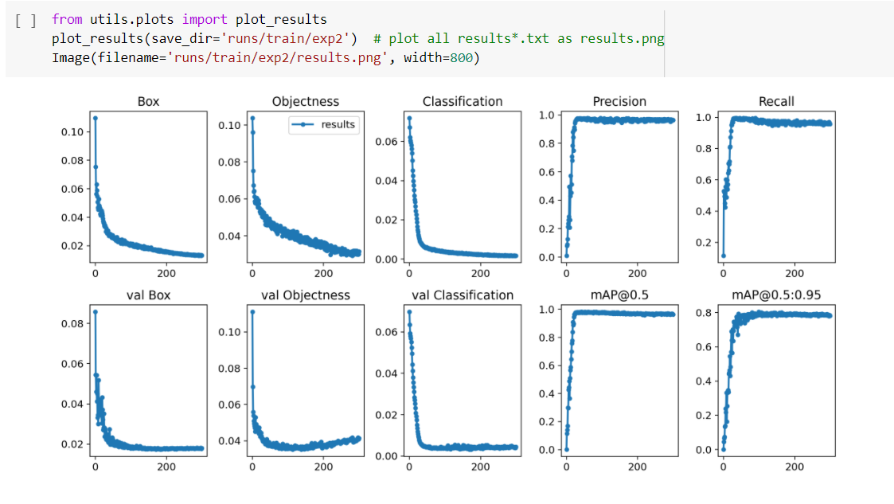
Model used for training and performance metrics
YOLOv5 Pytorch model has been used to train the dataset.

Slide 5
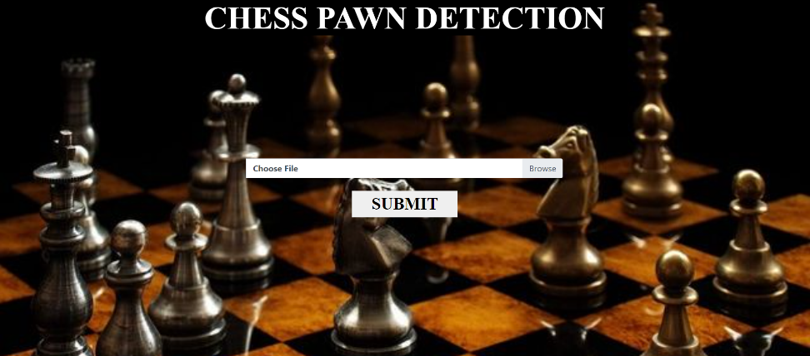
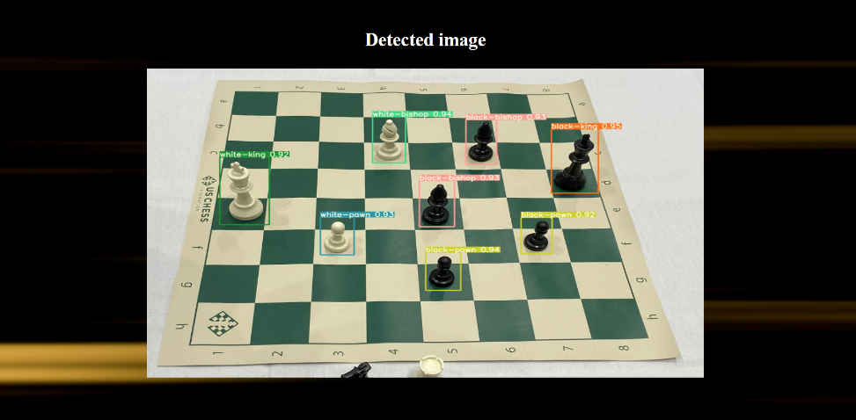
User Interface
Input Page
Output page

Slide 6
THANK YOU

